Slide 1
Operating System Lab(CSE 406) Presentation on Disk Scheduling Algorithms
University of Asia Pacific Department of CSE
Course teacher : Tahira Alam
(Assistant Professor)

Slide 2
Presented By
1
2
3
Mohamod Kabir Sadi | Biswambar Sarker | Niamul Hasan
ID : 17201002 | ID : 17201005 | ID : 17201026
Section: A1 | Section: A1 | Section: A1

Slide 3

Definition
Disk Scheduling Algo.!
Disk scheduling is done by operating systems to schedule I/O requests arriving for the disk.

Slide 4
Why Disk Scheduling is Important
1. Multiple I/O requests may arrive
2. Two or more request may be far
3. Hard drives are one of the slowest parts

Slide 5
Type of Disk Scheduling Algorithms
1.First Come -First Serve (FCFS)
2.Shortest Seek Time First (SSTF)
3.SCAN
4. C-SCAN
5. C-LOOK

Slide 6
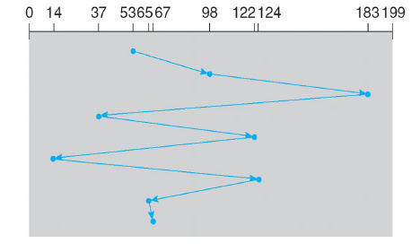
1. FCFS (First Come -First Serve )
Example:
Suppose the order of request is- (98,183,37,122,14,124,65,67)
And current position of Read/Write head is : 53
So, total distance:
= (98-53)+(183-98)+(183-37)+(122-37) +
(122-14)+(124-14)+(124-65)+(67-65)
= 45+85+146+85+108+110+54+2
=640

Slide 7
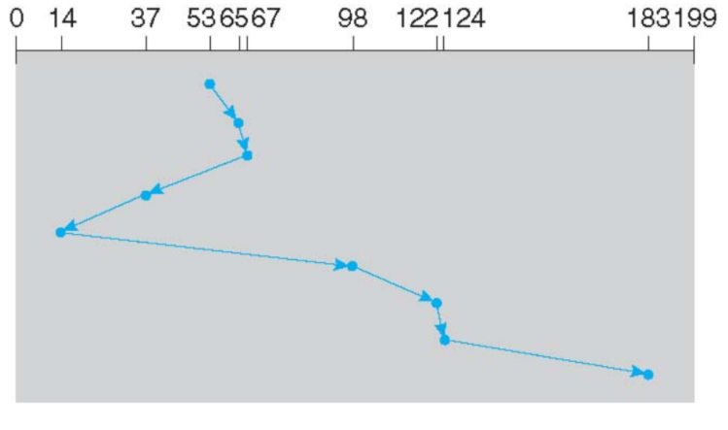
2. SSTF (Shortest Seek Time First)
if Given: queue:98,183,37,122,14,124,65,67
head: 53
Path: 53 65 67 37 14 98 122 124 183
Total distance: (65-53)+(67-65)+(67-37)+(37-14)+(98-14)+(122-98)+(124-122)+(183-124)

Slide 8
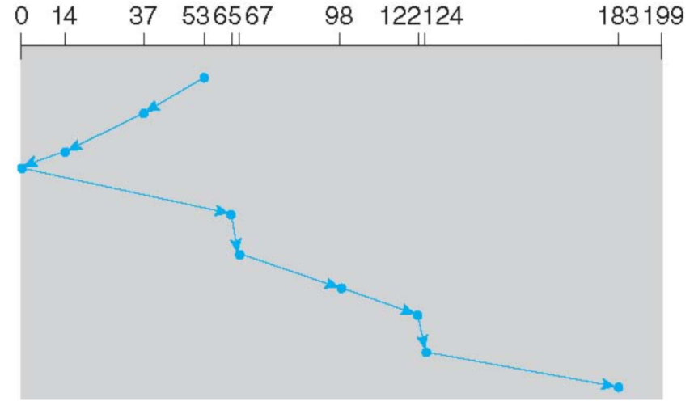
3. SCAN
if Given: queue:98,183,37,122,14,124,65,67
head: 53
Lower Bound: 0 Upper Bound:199
Path: 53 37 14 0 65 67 98 122 124 183
Total distance: (53-37)+(37-14)+(14-0)+(65-0)+(67-65)+(98-67)+(122-98)+(124-122)+(183-124)

Slide 9
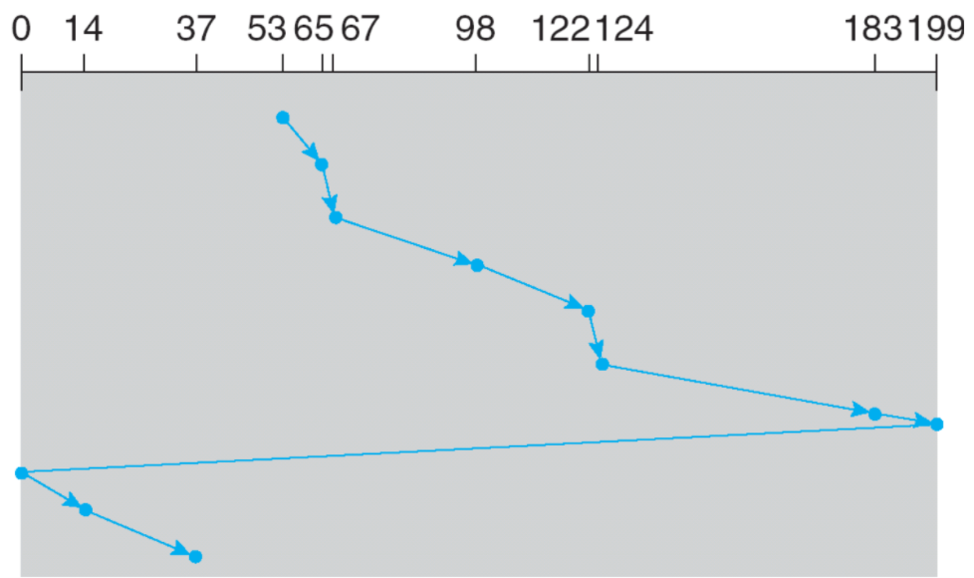
5. C-SCAN
if Given: queue:98,183,37,122,14,124,65,67
head: 53
Lower Bound: 0 Upper Bound:199
Path: 53, 65, 67, 98, 122, 124, 183, 199, 0, 14, 37
Total distance: (65-53)+(67-65)+(98-67)+(122-98)+(124-122)+(183-124)+(199-183)+(199-0)+(14-0)+(37-14)

Slide 10
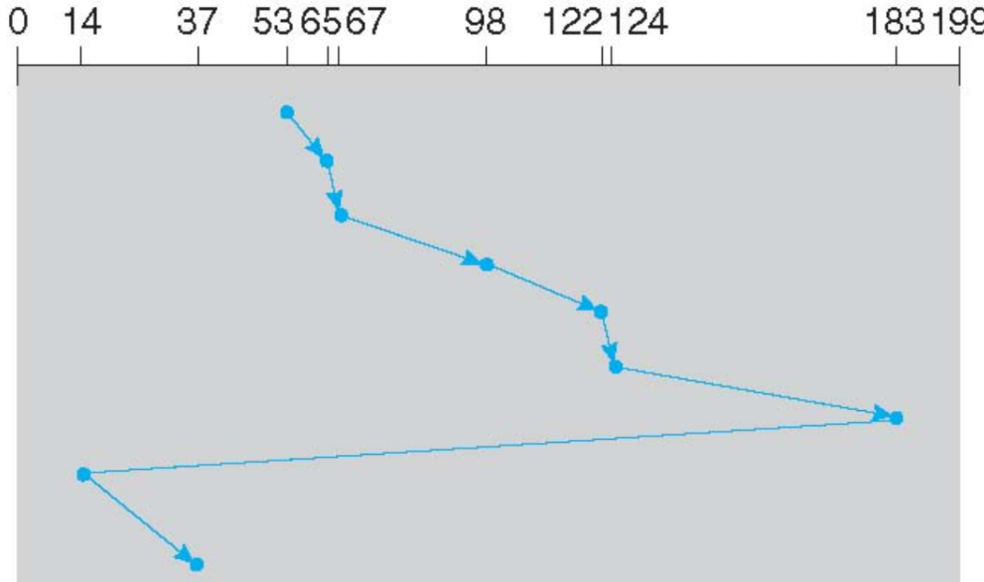
4. C-LOOK
if Given: queue:98,183,37,122,14,124,65,67
head: 53
Lower Bound: 0 Upper Bound:199
Path: 53, 65, 67, 98, 122, 124, 183, 14, 37
Total distance: (65-53)+(67-65)+(98-67)+(122-98)+(124-122)+(183-124)+(183-14)+(37-14)

Slide 11
THANK YOU!

